Slide 1
Category review: Chips
July 2026
Retail Analytics
Rohit Kumar Raut
Brand note: If client logo is not required, use alternate title page layout right click slide thumbnail > Layout > Title

Slide 2
Notes:
To view Privacy video explaining how important data privacy is to Quantium, please click here: https://www.youtube.com/watch?v=Zq1QDAkoRzU
or here Q:\Company Reference\Brand & Design\Brand videos\Q Privacy.mp4
At Quantium, we believe that data is the behavioural footprint of humanity and that it has to be treated with the utmost care and responsibility.
Histories, attitudes, indeed lives are stored within it in ways that aren’t always apparent – and that’s what makes its potential so powerful.
To work with it responsibly, sensitively, we set ourselves the highest data privacy protection and governance standards.
We have spent 17 years perfecting privacy-by-design and secure-by-design principles. Central to this is not holding any personally identifiable information about people –
we neither receive it, and put the necessary protections in place to be unable to decipher it.
Every aspect of handling data is safeguarded: from its de-identification, to its encryption – data security is paramount and of the highest grade.
We pride ourselves on gaining the trust of iconic organisations around the world through years of securely working with their data,
and in turn the trust that builds with their stakeholders.

Slide 3
Executive summary
01
Task 1
Customer Analytics Mainstream Young Singles/Couples and Mainstream Retirees drive the highest chip category sales, together representing over 14,300 customers. Young Singles/Couples over-index on large packs (270g-380g) and brands like Tyrrells, Kettle and Doritos. We recommend prioritising these two segments in the upcoming category strategy, with tailored brand and pack-size focus for each.
02
Task 2
Trial Store Performance The new store layout drove a statistically significant sales uplift in 2 of 3 trial stores (+40% to +66% by the final month), driven by increased customer visits. We recommend a broader rollout, with the third store's weaker result flagged for further investigation before a full chain-wide commitment.

Slide 4
01
Category

Slide 5
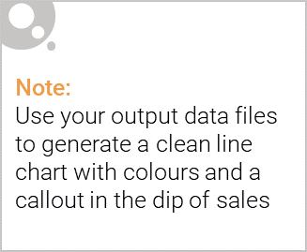
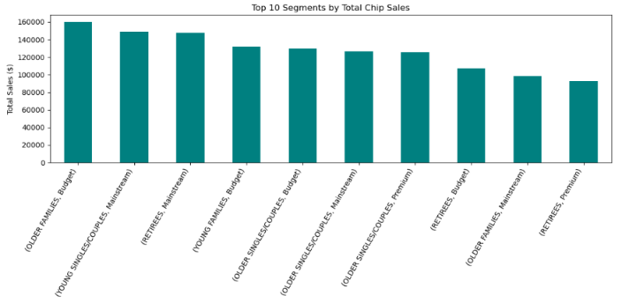
Overview:
Older Families, Young Singles/Couples and Retirees together account for the majority of total chip category sales. Mainstream Young Singles/Couples alone contributes $149k in sales from a customer base of nearly 8,000 — the largest single segment by customer count.

Slide 6

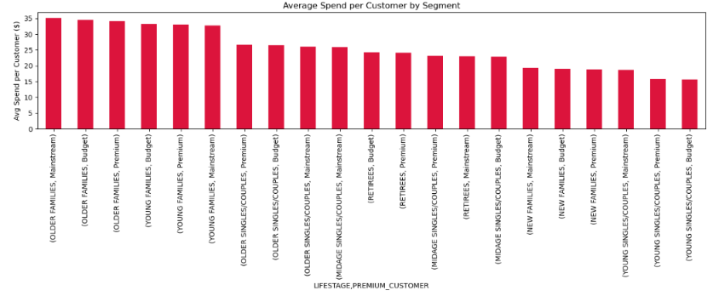
Affluence and spending behaviour
Category sales are driven more by customer volume than by premium spending.
Mainstream Young Singles/Couples has the largest customer base but only
average spend per customer ($18.77). In contrast, Older Families spend
the most per customer ($35.09) despite a much smaller customer base
a high-value, lower-volume segment.

Slide 7
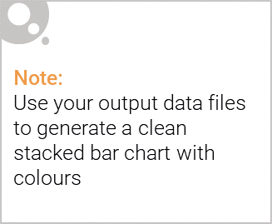
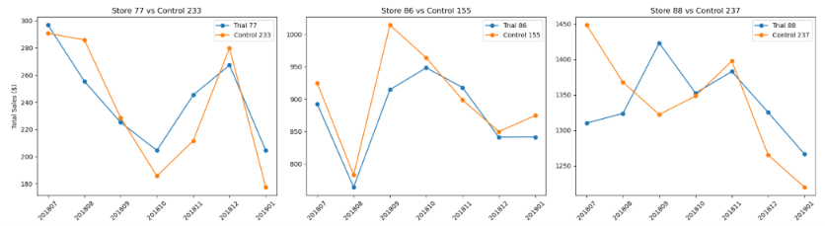
Editable (delete this)
Customer distribution by segment
Young Singles/Couples (Mainstream) is the single largest customer segment by count. This scale - not premium spending - is what makes them the priority target for the category strategy.

Slide 8
02
Trial store performance

Slide 9
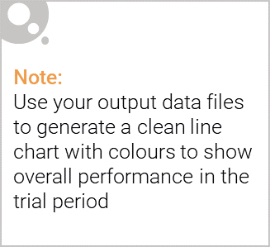
Selecting control stores
Control stores were selected using a combined similarity score based on sales, customer numbers and transactions per customer during the 7-month pre-trial period, then validated visually to confirm both trend and scale matched closely before finalising:
Trial Store 77 → Control Store 233
Trial Store 86 → Control Store 155
Trial Store 88 → Control Store 237

Slide 10
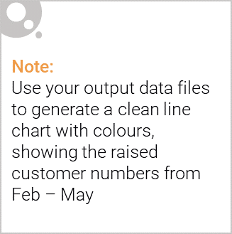
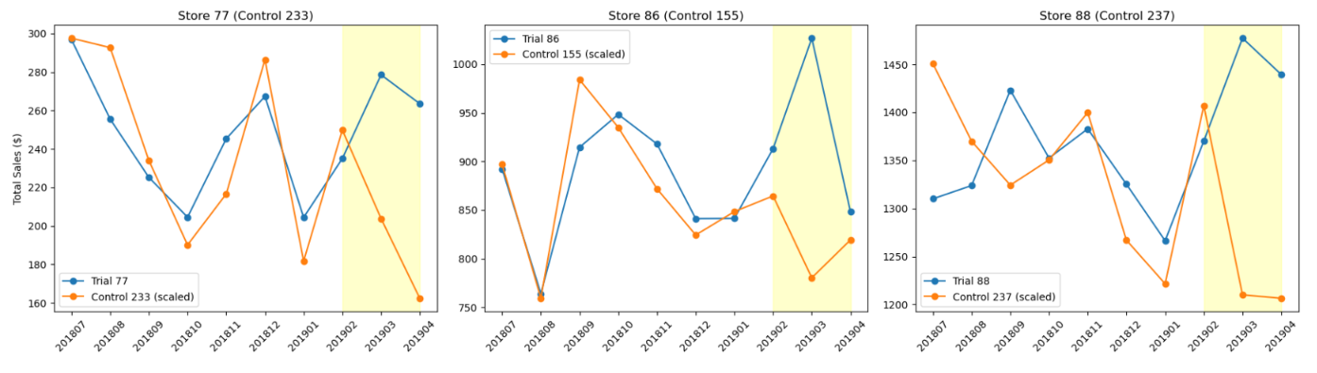
Trial results
Stores 77 and 88 showed a significant, growing sales uplift during the trial period (up to +66% and +19-22% respectively), driven by increased customer visits rather than higher spend per customer.
Store 86 showed a weaker, inconsistent result — a sales uplift only in month 2 of the trial, despite increased customer visits throughout. This suggests store-specific factors may be affecting conversion and should be investigated before a full rollout.
Recommendation: Roll out the new layout more broadly, prioritising stores similar to 77 and 88, while investigating Store 86's execution before including it in a wider rollout.

